Slide 1
Pointers and Strings

Slide 2
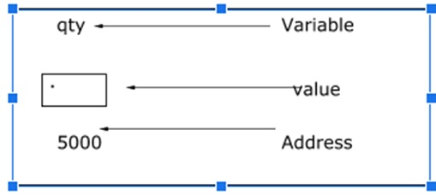
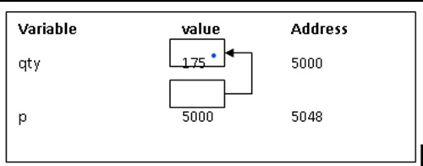
Pointer
The pointers perform the function of storing the addresses of other variables in the program.
These variables could be of any type- char, int, function, array, or other pointers.
The pointer sizes depend on their architecture. But, keep in mind that the size of a pointer in the 32-bit architecture is 2 bytes.

Slide 3
Declaration of a Pointer
Just like the variables, we also have to declare the pointers in C before we use them in any program. We can name these pointers anything that we like, as long as they abide by the naming rules of the C language. Normally, the declaration of a pointer would take a form like this:
data_type * name_of_pointer_variable;
The data_type refers to this pointer’s base type in the variable of C. It indicates which type of variable is the pointer pointing to in the code.
The asterisk ( * ) is used to declare a pointer. It is an indirection operator, and it is the same asterisk that we use in multiplication.
We can declare pointers in the C language with the use of the asterisk symbol ( * ). It is also called the indirection pointer, as we use it for dereferencing any pointer. Here is how we use it:
int *q; // a pointer q for int data type
char *x; // a pointer x for char data type

Slide 4
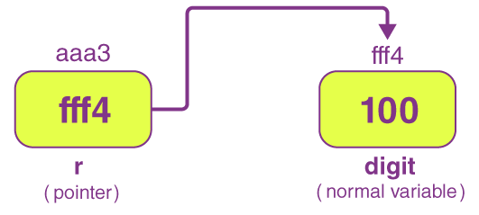
Initialization of a Pointer
Once we declare a pointer, we then initialize it just like the standard variables using an address of the variable. In case we don’t initialize the pointers in any C program and start using it directly, the results can be pretty unpredictable and potentially disastrous.
We use the & (ampersand) operator to get the variable’s address in the program. We place the & just before that variable’s name whose address we require.
Syntax of Pointer declaration and Initialization:
data_type *pointer;
data_type variable;
pointer = &variable;

Slide 5
Types of Pointers
There are majorly four types of pointers, they are:
Null Pointer
Void Pointer
Wild Pointer
Dangling Pointer

Slide 6
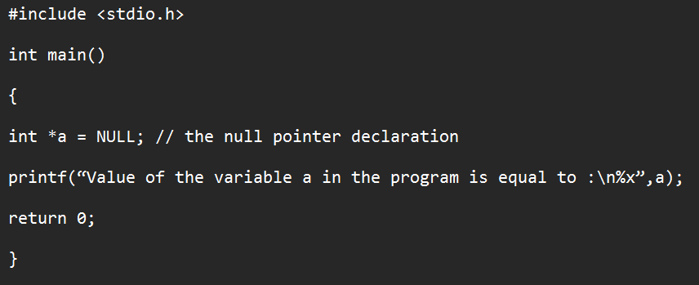
Null pointer
The null pointer has a value of 0. To create a null pointer in C, we assign the pointer with a null value during its declaration in the program. This type of method is especially useful when the pointer has no address assigned to it.

Slide 7
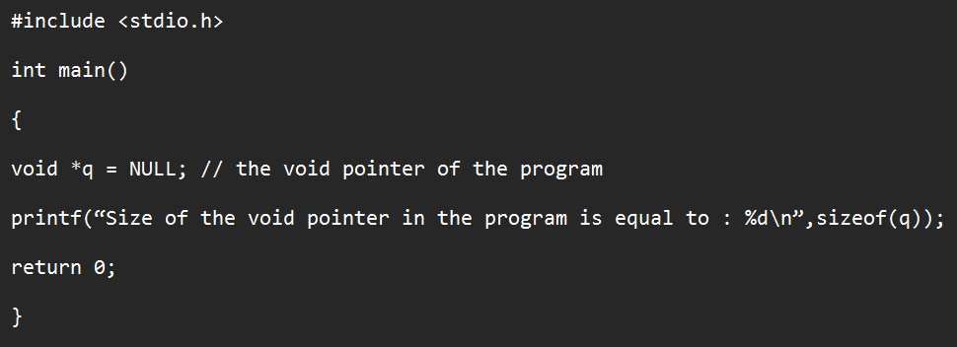
Void Pointer
The void pointer is also known as the generic pointer in the C language. This pointer has no standard data type, and we create it with the use of the keyword void. The void pointer is generally used for the storage of any variable’s address.

Slide 8
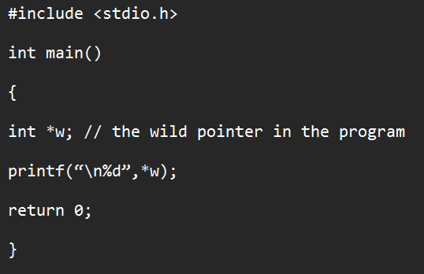
Wild Pointer
We can call a pointer a wild pointer if we haven’t initialized it with anything. Such wild pointers are not very efficient in a program, as they may ultimately point towards some memory location that is unknown to us. It will ultimately lead to some problems in the program, and then, it will crash. Thus, you must be very careful when using wild pointers in a program.

Slide 9
Dangling Pointer
The pointers pointing to a deallocated memory block are known as Dangling Pointers.
This condition generates an error known as Dangling Pointer Problem.
Dangling Pointer occurs when a pointer pointing to a variable goes out of scope or when an object/variable's memory gets deallocated.
The occurrence of Dangling Pointers can result in some unexpected errors during the execution of a program
There are ways to avoid Dangling Pointer Problems like assigning NULL to the pointer when the memory gets deallocated.
Notes:
In general, Dangling means to hang freely. So as the name suggests, Dangling Pointers are the pointers that point to some freed/deleted location from the program's memory (memory that is currently not in the use of the program). When we talk about allocation and deallocation of memory blocks, we see Dynamic Memory Allocation concepts. In Dynamic Memory Allocation, generally, we use malloc(), calloc() functions to allocate a memory block and free() function to deallocate a memory block in C Language. So, once we deallocate a memory block using the free() function, a Dangling Pointer is generated.

Slide 10
Pointer to Pointer
Pointer itself are variables whose locations are specifies on memory and their storage address too can be known by assigning a pointer.
We can access a target value indirectly pointed to by a pointer by applying the indirection operator or the asterisk mark twice.

Slide 11
Pointer Expressions
Arithmetic operations between two or more pointer is not possible.
But pointers can be used to perform arithmetic operations on the value they point to.
((*p1) * (*p2)) / (*p3)
(10 * (-(*p3))) / (*p2)
Note to keep a space between / and * to not to make compiler interpret it to be a comment.

Slide 12
Pointer Operators
C provides two pointer operators, which are (a) Address of Operator ‘&’ and (b) Indirection Operator ‘*’.
A pointer is a variable that contains the address of another variable or you can say that a variable that contains the address of another variable is said to "point to" the other variable. A variable can be any data type including an object, structure or again pointer itself.
The Address of Operator &
The & is a unary operator that returns the memory address of its operand. For example, if var is an integer variable, then &var is its address. This operator has the same precedence and right-to-left associativity as the other unary operators.
The Indirection Operator *
The second operator is indirection Operator *, and it is the complement of &. It is a unary operator that returns the value of the variable located at the address specified by its operand.

Slide 13
Operations on pointers
The different operations that can be possibly performed on pointers are:
Incrementing/Decrementing a pointer
Addition/Subtraction of a constant number to a pointer
Subtraction of one pointer from another
Comparison of two pointers
Operations not possible with pointers
There are a few operations that are not possible with pointers. These are:
Addition of two pointer variables
Multiplication of a pointer with a constant value
Division of a pointer with a constant value

Slide 14
Incrementing/Decrementing and /Addition/Subtraction of a constant number to a pointer
Pointer incrementation is valid in ‘C’ .
e.g.: p++; OR ;p--
Addition or subtraction of a constant to a pointer is allowed in C.
p1=p1+2; are valid statements .
p2=p2-2; are valid statements .
A pointer, when incremented, it increases it’s value by the length of the data type it points to.
characters – 1 byte Float – 4 bytes
integer – 2 bytes double – 8 bytes

Slide 15
Passing pointers to functions
C programming allows passing a pointer to a function. To do so, simply declare the function parameter as a pointer type.

Slide 16
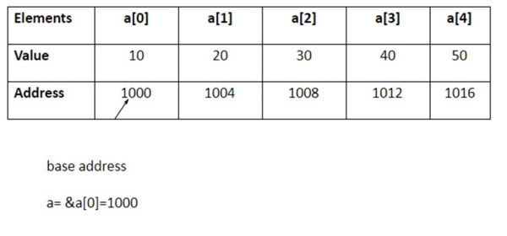
Pointers and one-dimensional array in C
The compiler allocates Continuous memory locations for all the elements of the array.
The base address = first element address (index 0) of the array.
For Example − int a [5] = {10, 20,30,40,50};
If ‘p’ is declared as integer pointer, then, an array ‘a’ can be pointed by the following assignment −
p = a;
(or) p = &a[0];
Every value of 'a' is accessed by using p++ to move from one element to another element. When a pointer is incremented, its value is increased by the size of the datatype that it points to. This length is called the "scale factor".
The relationship between ‘p’ and 'a' is explained below −
P = &a[0] = 1000
P+1 = &a[1] = 1004
P+2 = &a[2] = 1008
P+3 = &a[3] = 1012
P+4 = &a[4] = 1016

Slide 17
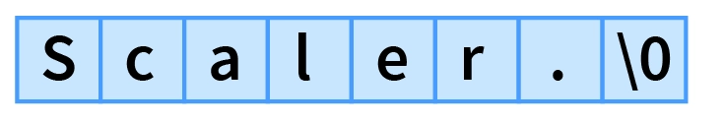
Strings
Strings in C are robust data structures for storing information. They can be implemented with either a one-dimensional array of characters or pointers. There are many ways to initialize a string in C. These strings can be used to read lines of text and can also be passed to functions.
A string is a collection of characters (i.e., letters, numerals, symbols, and punctuation marks) in a linear sequence. In C, a string is a sequence of characters concluded with a NULL character '\0’
Strings in C are enclosed within double quotes(" "), whereas characters are enclosed within single quotes(' ‘).
When the compiler finds a sequence of characters enclosed within the double quotation marks, it adds a null character (\0) at the end by default.

Slide 18
String declaration
A String in C is an array with character as a data type. C does not directly support string as a data type, as seen in other programming languages like C++. Hence, character arrays must be used to display a string in C. The general syntax of declaring a string in C is as follows:
char variable[array_size];
Thus, the classic declaration can be made as follows:
char str[5];
char str2[15];
It is vital to note that we should always account for an extra space used by the null character(\0).

Slide 19
String initialization
1. Assigning a string literal with size
We can directly assign a string literal to a character array keeping in mind to keep the array size at least one more than the length of the string literal that will be assigned to it.
For example:
char str[8] = "Scalar.";
The string length here is 7, but we have kept the size to be 8 to account for the Null character. The compiler adds the Null character(\0) at the end automatically.
char str[3] = "Scalar.";
printf("%s",str);

Slide 20
String initialization
2. Assigning a string literal without size
It is also possible to directly assign a string literal to a character array without any size. The size gets determined automatically by the compiler at compile time.
char str[] = "Scalar.";
The critical thing to remember is that the name of the string, here "str" acts as a pointer because it is an array.
3. Assigning character by character with size
We can also assign a string character by character. However, it is essential to set the end character as '\0'. For example:
char str[8] = {'S', 'c', 'a', 'l', ‘a', 'r', '.','\0'};

Slide 21
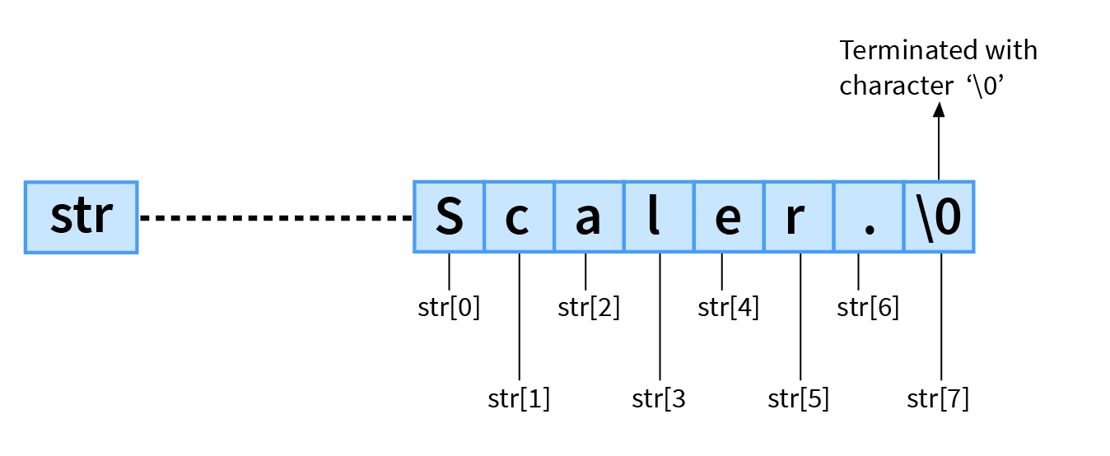
String initialization
4. Assigning character by character without size
Like assigning directly without size, we also assign character by character with the Null Character at the end. The compiler will determine the size of the string automatically.
char str[] = {'S', 'c', 'a', 'l’, ‘e', 'r', '.','\0'};

Slide 22
Read String from the user
The most common operation used for reading a string is scanf(), which reads a sequence of characters until it encounters whitespace (i.e., space, newline, tab, etc.).
char str[25];
scanf("%s", str);
If we provide the following input:
Scaler is amazing.
We get the following Output:
Scaler

Slide 23
Read a line of text
The scanf() operation cannot read strings with spaces as it automatically stops reading when it encounters whitespace. To read and print strings with whitespace, we can use the combination of fgets() and puts():
fgets(): The fgets() function is used to read a specified number of characters. Its declaration looks as follows:
fgets(name_of_string, number_of_characters, stdin);
name_of_string*: It is the variable in which the string is going to be stored.
number_of_characters: The maximum length of the string should be read.
stdin: It is the filehandle from where the string is to be read.
puts(): puts() is very convenient for displaying strings.
puts(name_of_string);
name_of_string: It is the variable in which the string will be stored.

Slide 24
String manipulation functions
You need to often manipulate strings according to the need of a problem. Most, if not all, of the time string manipulation can be done manually but, this makes programming complex and large.
To solve this, C supports a large number of string handling functions in the standard library "string.h".
Function | Work of Function
strlen() | computes string's length
strcpy() | copies a string to another
strcat() | concatenates(joins) two strings
strcmp() | compares two strings
strlwr() | converts string to lowercase
strupr() | converts string to uppercase

Slide 25
Classes and Data Abstraction
Data abstraction is one of the most essential and important features of object-oriented programming in C++.
Abstraction means displaying only essential information and hiding the details.
Data abstraction refers to providing only essential information about the data to the outside world, hiding the background details or implementation.
Consider a real-life example of a man driving a car. The man only knows that pressing the accelerator will increase the speed of the car or applying brakes will stop the car but he does not know how on pressing the accelerator the speed is actually increasing, he does not know about the inner mechanism of the car or the implementation of the accelerator, brakes, etc in the car. This is what abstraction is.

Slide 26
Types of Abstraction
Data abstraction – This type only shows the required information about the data and hides the unnecessary data.
Control Abstraction – This type only shows the required information about the implementation and hides unnecessary information.
Abstraction using Classes
We can implement Abstraction in C++ using classes. The class helps us to group data members and member functions using available access specifiers. A Class can decide which data member will be visible to the outside world and which is not.
Abstraction in Header files
One more type of abstraction in C++ can be header files. For example, consider the pow() method present in math.h header file. Whenever we need to calculate the power of a number, we simply call the function pow() present in the math.h header file and pass the numbers as arguments without knowing the underlying algorithm according to which the function is actually calculating the power of numbers.

Slide 27
Advantages of Data Abstraction
Helps the user to avoid writing the low-level code
Avoids code duplication and increases reusability.
Can change the internal implementation of the class independently without affecting the user.
Helps to increase the security of an application or program as only important details are provided to the user.
It reduces the complexity as well as the redundancy of the code, therefore increasing the readability.

Slide 28
Inheritance
The capability of a class to derive properties and characteristics from another class is called Inheritance. Inheritance is one of the most important features of Object-Oriented Programming.
Inheritance is a feature or a process in which, new classes are created from the existing classes. The new class created is called “derived class” or “child class” and the existing class is known as the “base class” or “parent class”. The derived class now is said to be inherited from the base class.
Sub Class: The class that inherits properties from another class is called Subclass or Derived Class.
Super Class: The class whose properties are inherited by a subclass is called Base Class or Superclass

Slide 29
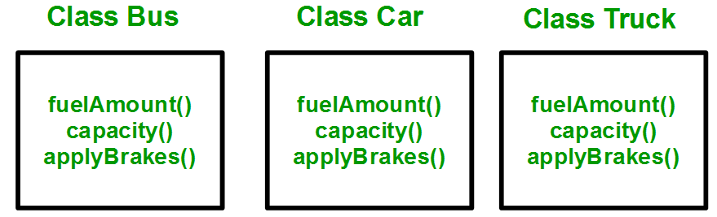
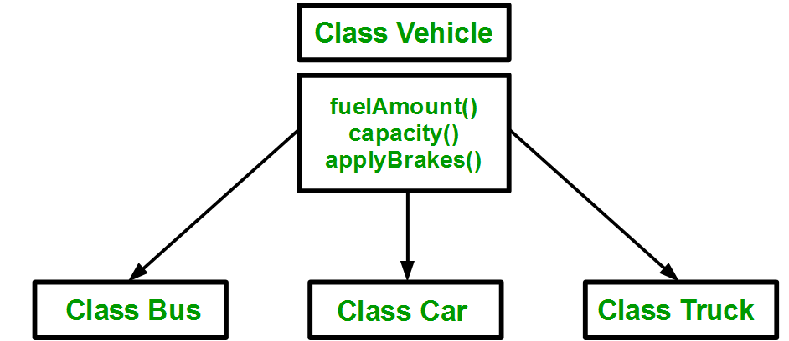
Why and when to use inheritance?
Consider a group of vehicles. You need to create classes for Bus, Car, and Truck. The methods fuelAmount(), capacity(), applyBrakes() will be the same for all three classes. If we create these classes avoiding inheritance then we have to write all of these functions in each of the three classes as shown below figure:
You can clearly see that the above process results in duplication of the same code 3 times. This increases the chances of error and data redundancy. To avoid this type of situation, inheritance is used. If we create a class Vehicle and write these three functions in it and inherit the rest of the classes from the vehicle class, then we can simply avoid the duplication of data and increase re-usability. Look at the below diagram in which the three classes are inherited from vehicle class:

Slide 30
C++ I/O (Input / Output)
C++ comes with libraries that provide us with many ways for performing input and output. In C++ input and output are performed in the form of a sequence of bytes or more commonly known as streams.
Input Stream: If the direction of flow of bytes is from the device(for example, Keyboard) to the main memory then this process is called input.
Output Stream: If the direction of flow of bytes is opposite, i.e. from main memory to device( display screen ) then this process is called output.
Header files available in C++ for Input/Output operations are:
iostream: iostream stands for standard input-output stream. This header file contains definitions of objects like cin, cout, cerr, etc.
iomanip: iomanip stands for input-output manipulators. The methods declared in these files are used for manipulating streams. This file contains definitions of setw, setprecision, etc.
fstream: This header file mainly describes the file stream. This header file is used to handle the data being read from a file as input or data being written into the file as output.

Slide 31
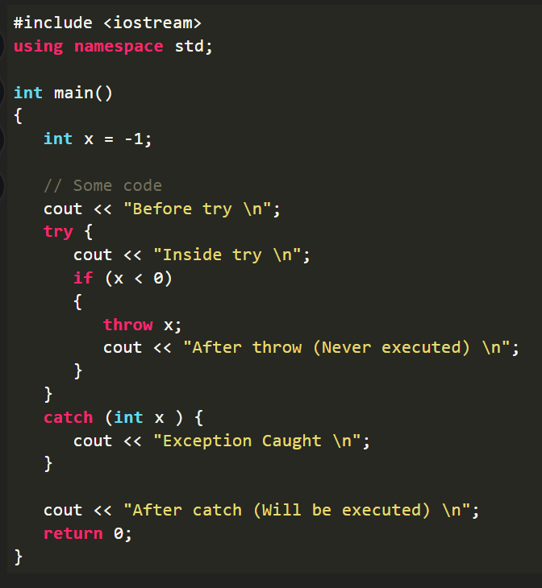
Exception Handling in C++
One of the advantages of C++ over C is Exception Handling. Exceptions are runtime anomalies or abnormal conditions that a program encounters during its execution.
There are two types of exceptions: a)Synchronous, b)Asynchronous (i.e., exceptions which are beyond the program’s control, such as disc failure, keyboard interrupts etc.).
C++ provides the following specialized keywords for this purpose:
try: Represents a block of code that can throw an exception.
catch: Represents a block of code that is executed when a particular exception is thrown.
throw: Used to throw an exception. Also used to list the exceptions that a function throws but doesn’t handle itself.

Slide 32
#include<stdio.h> int main(){ printf(“Thank you\n”); return 0; }

